Slide 1
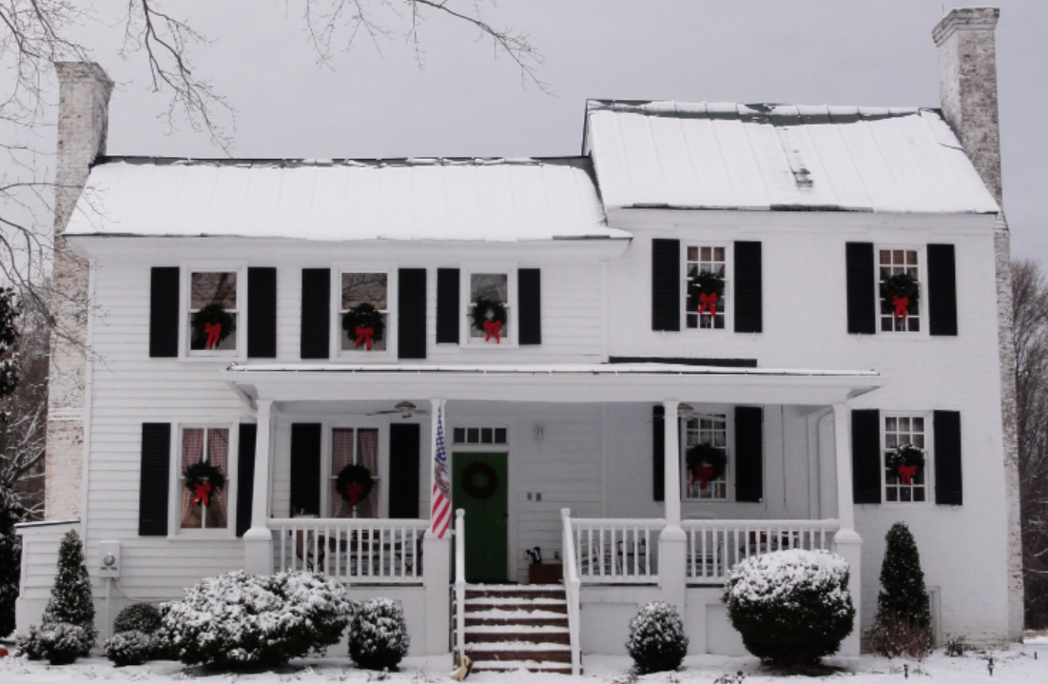
Mahockney – Catalog of Brickwork

Slide 2
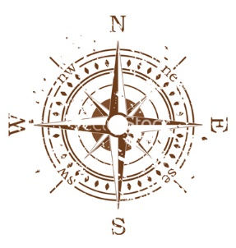

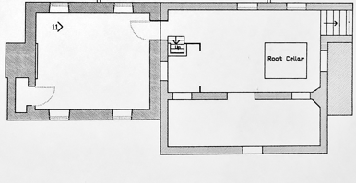




Mahockney’s Paired Basements: Foundational Evidence of Construction Chronology
Mahockney Cellar
(South side)
- Period I
Mahockney Cellar
(North side)
- Period II
Bricked Pit

Slide 3
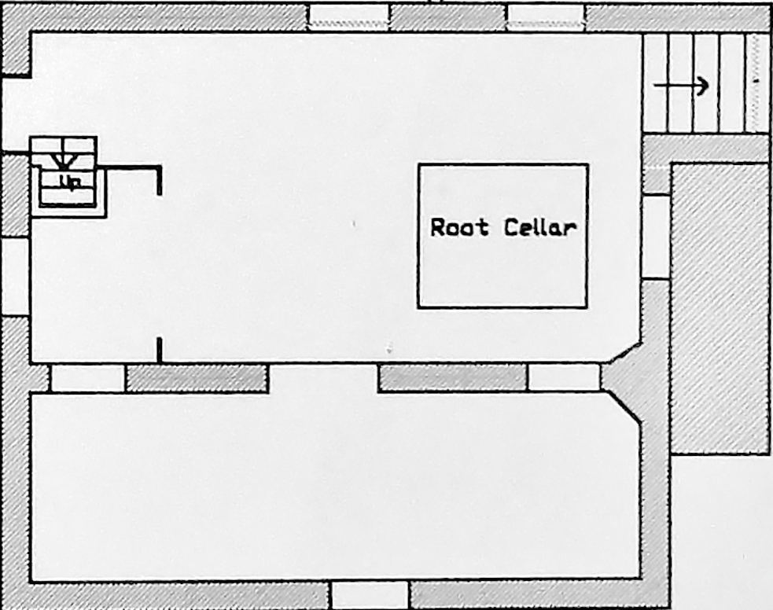
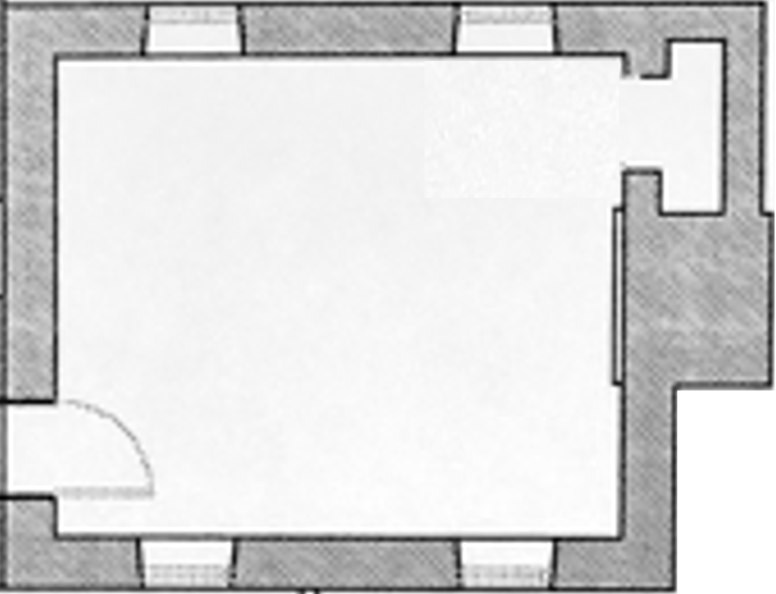





Flemish Bond Chimney
Flemish Bond Chimney
English Bond
Flemish Bond

Slide 4
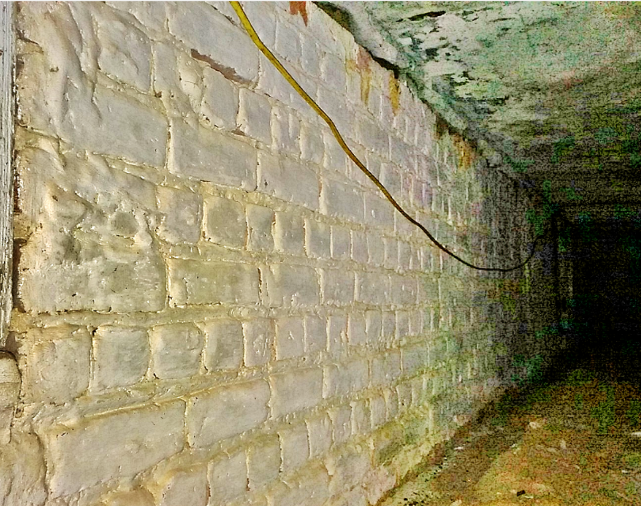
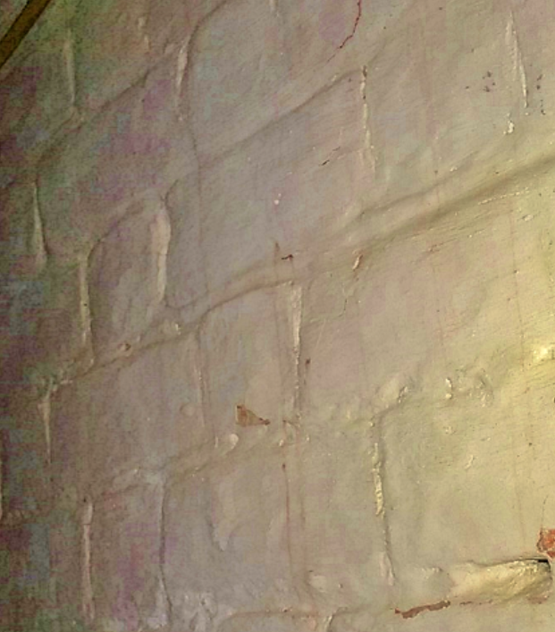
Joined East wall, under front porch
English Bond
Flemish Bond

Slide 5
Close-Ups
Mahockney Cellar
(South side)

Slide 6

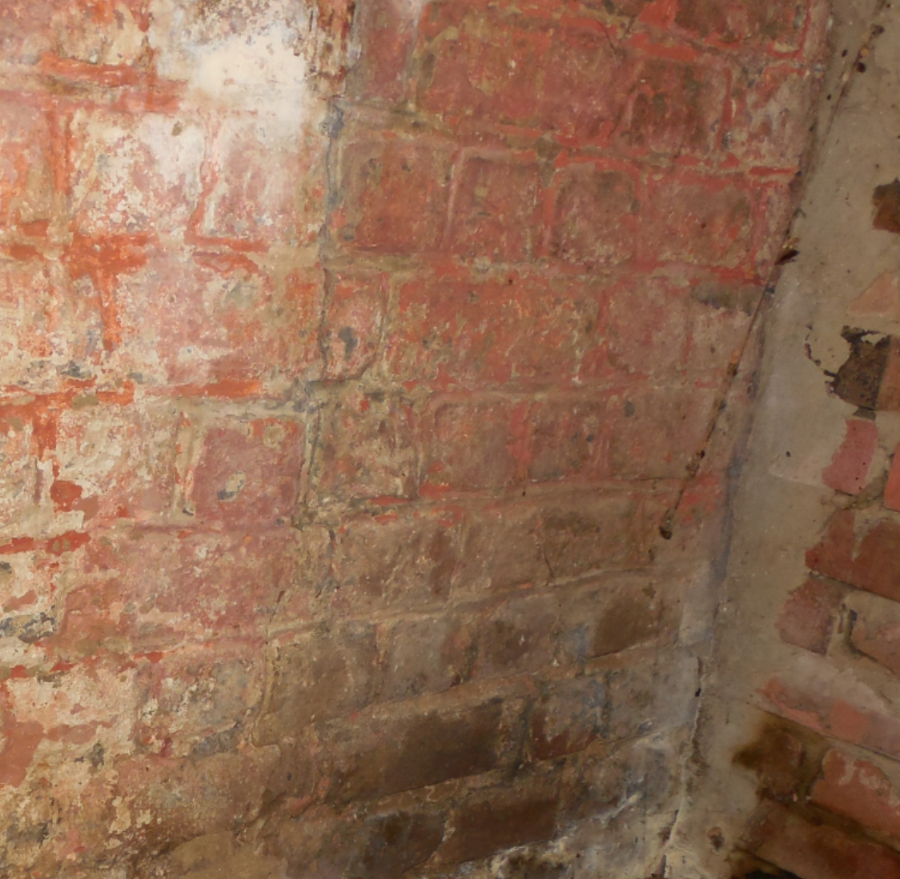
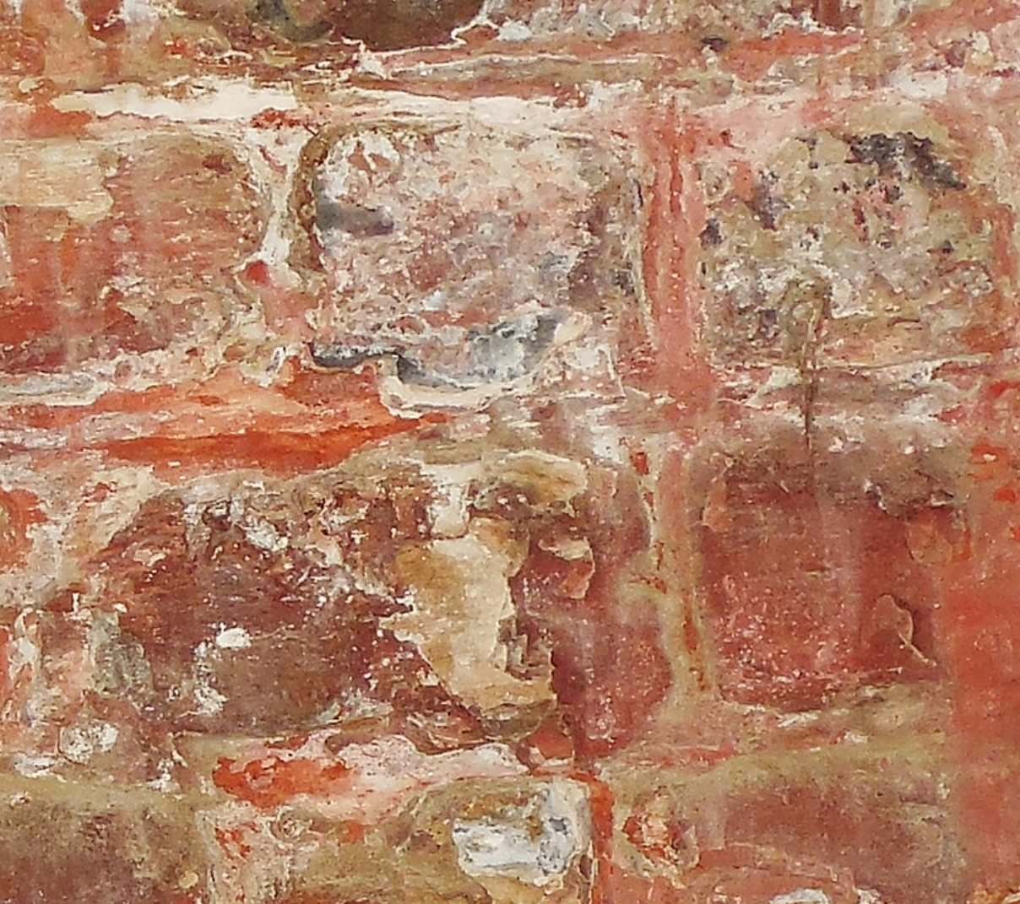
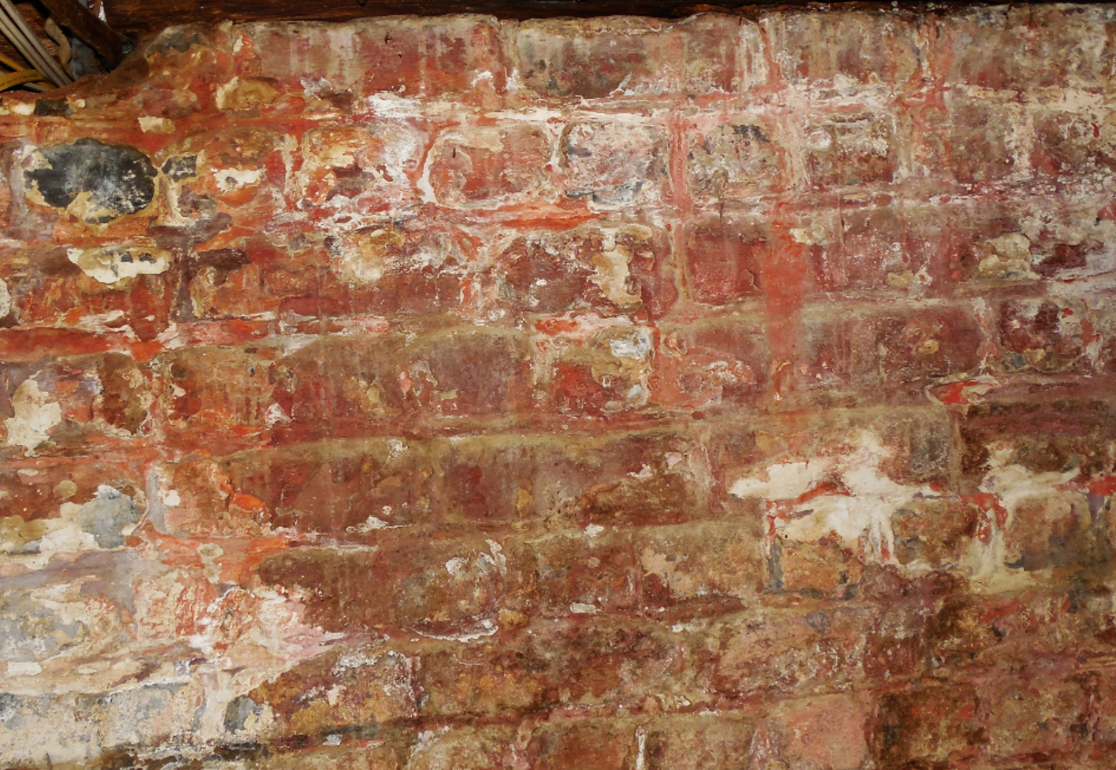
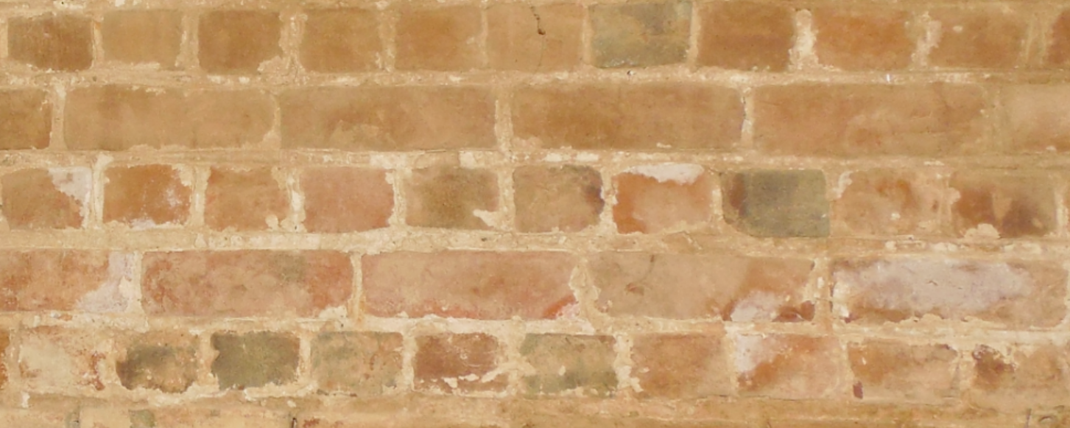
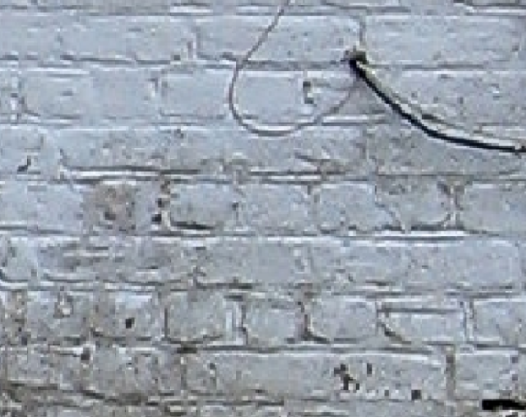
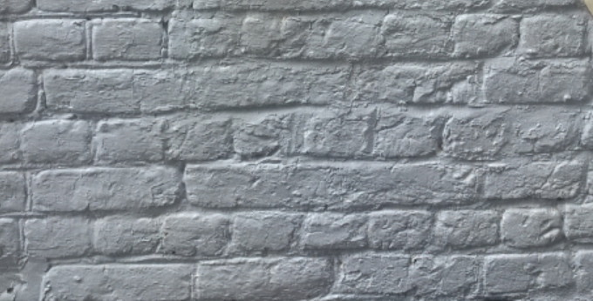

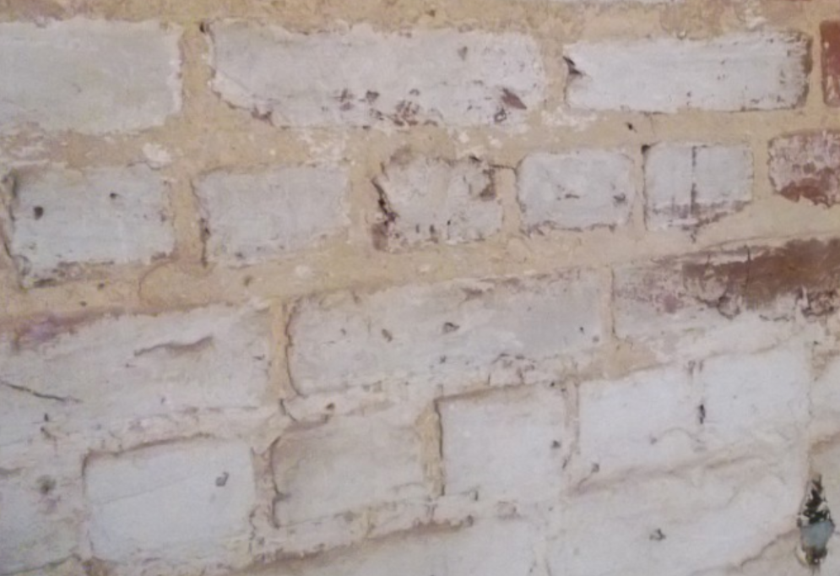
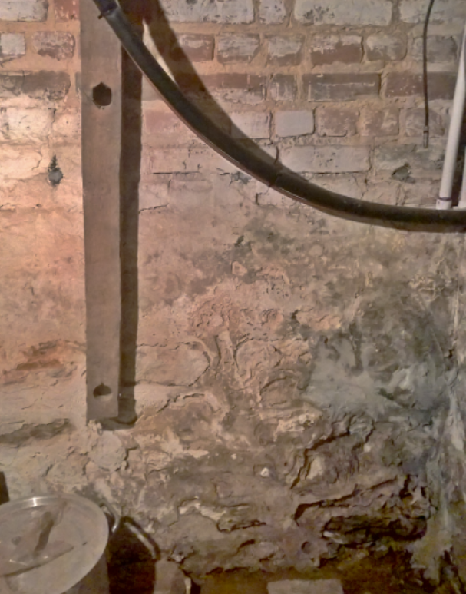
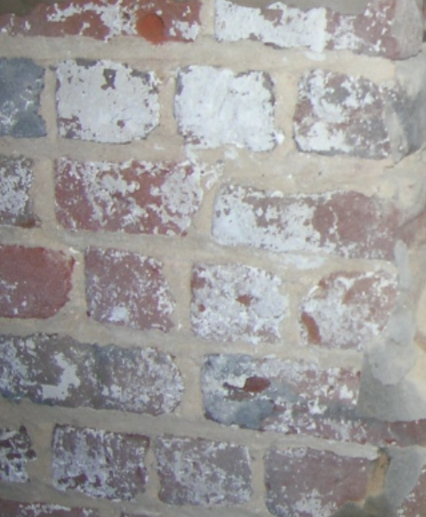
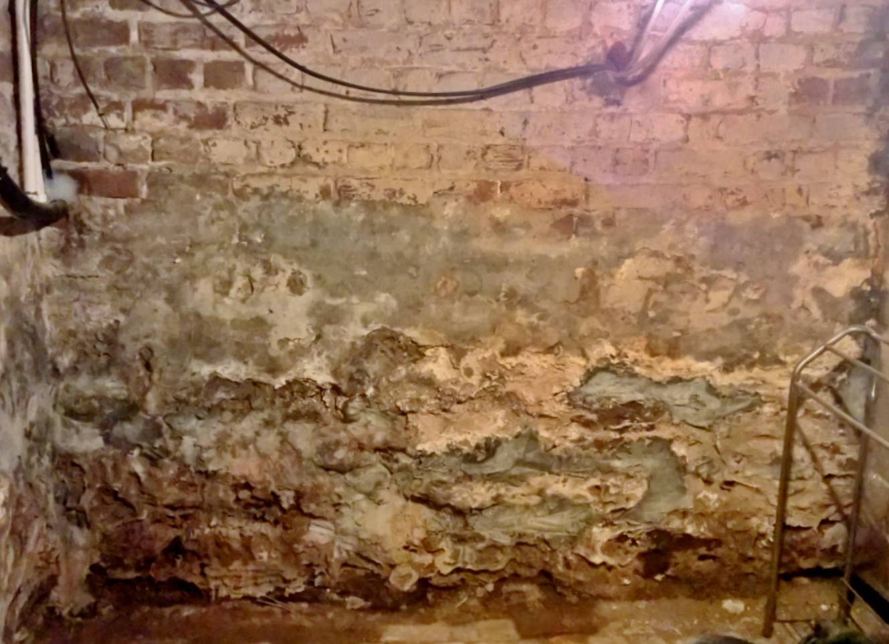
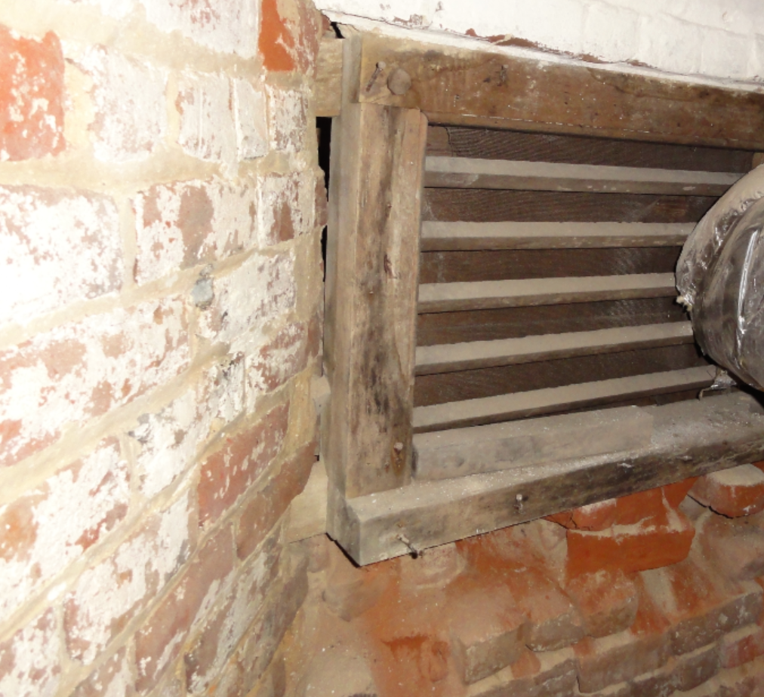
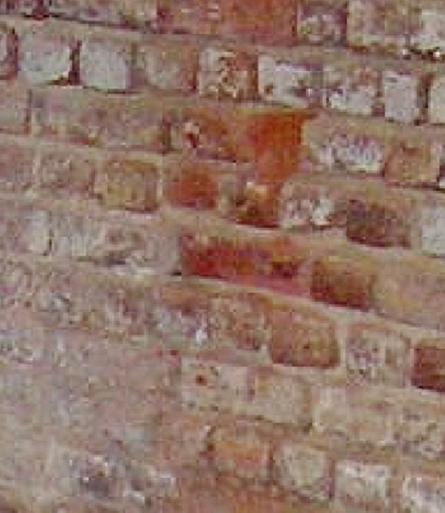
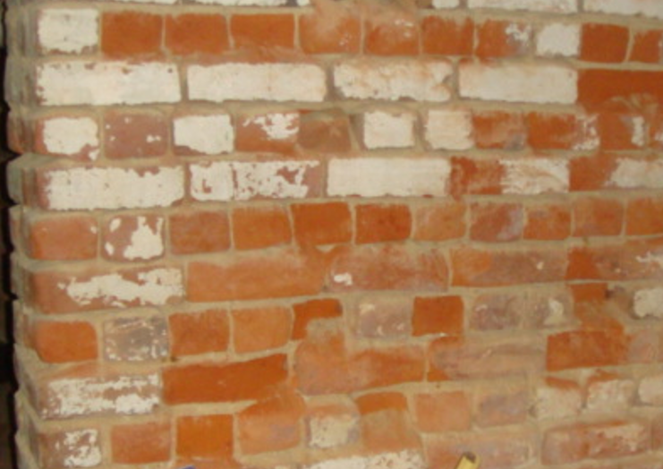
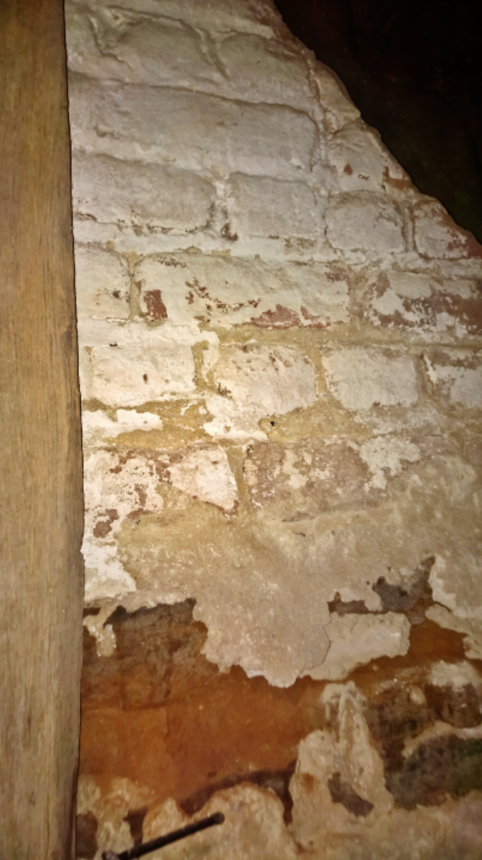
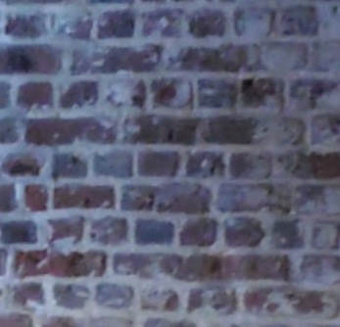
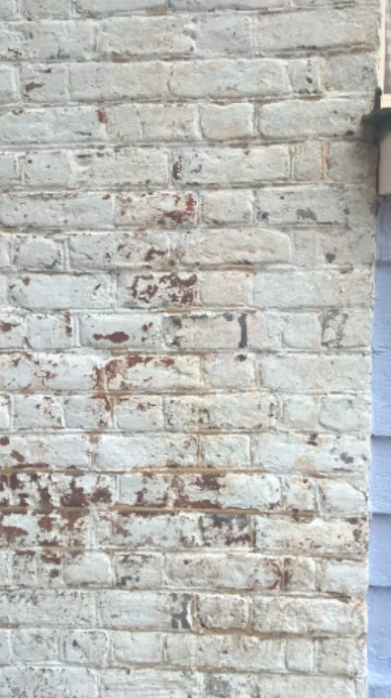
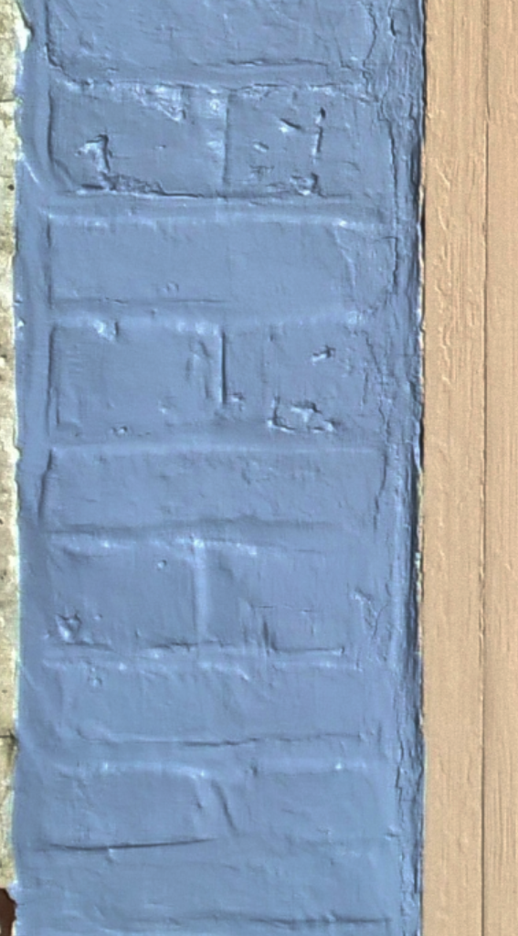
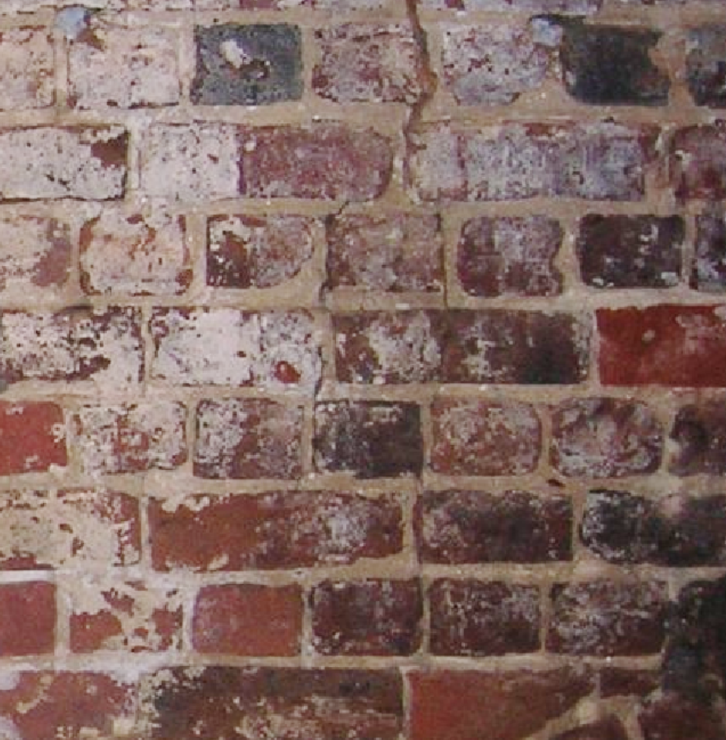
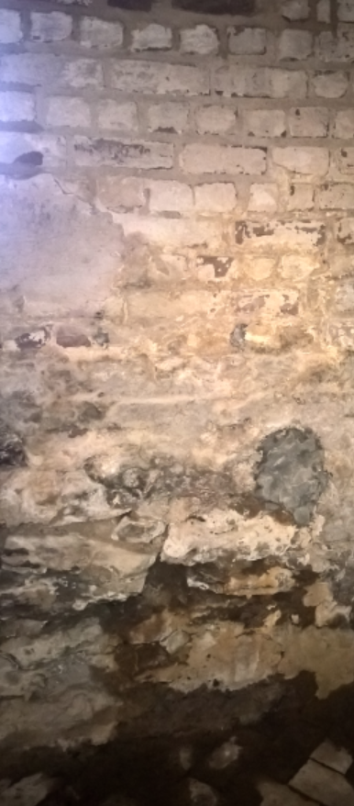
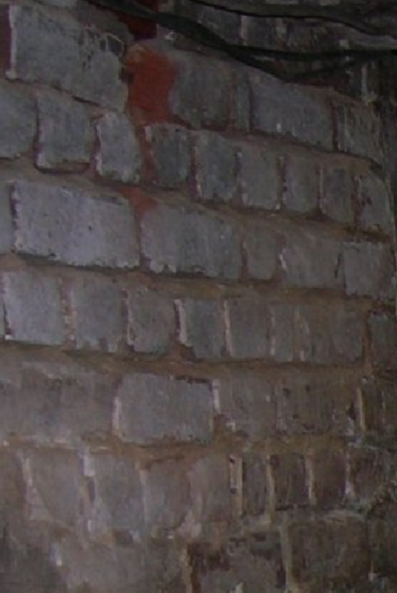
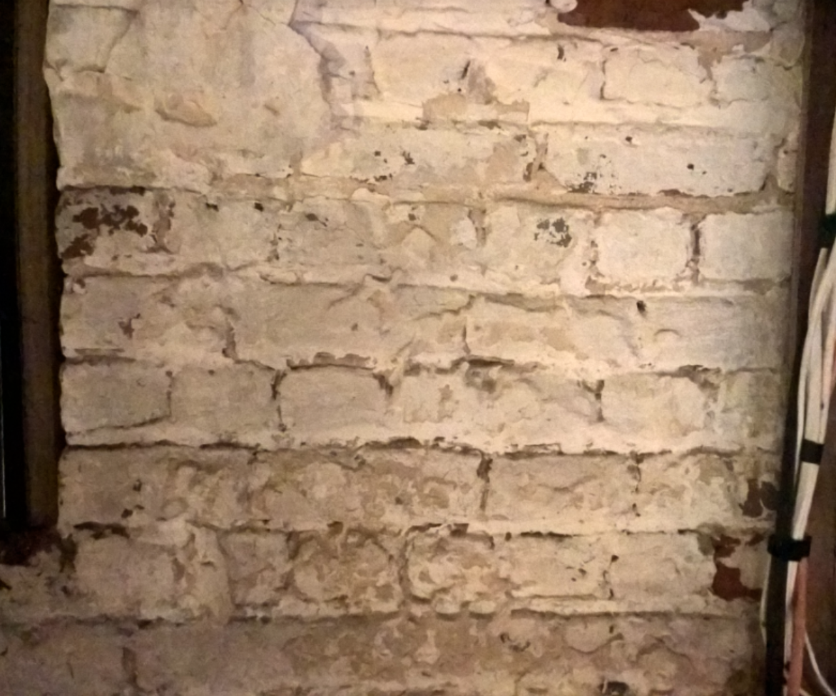
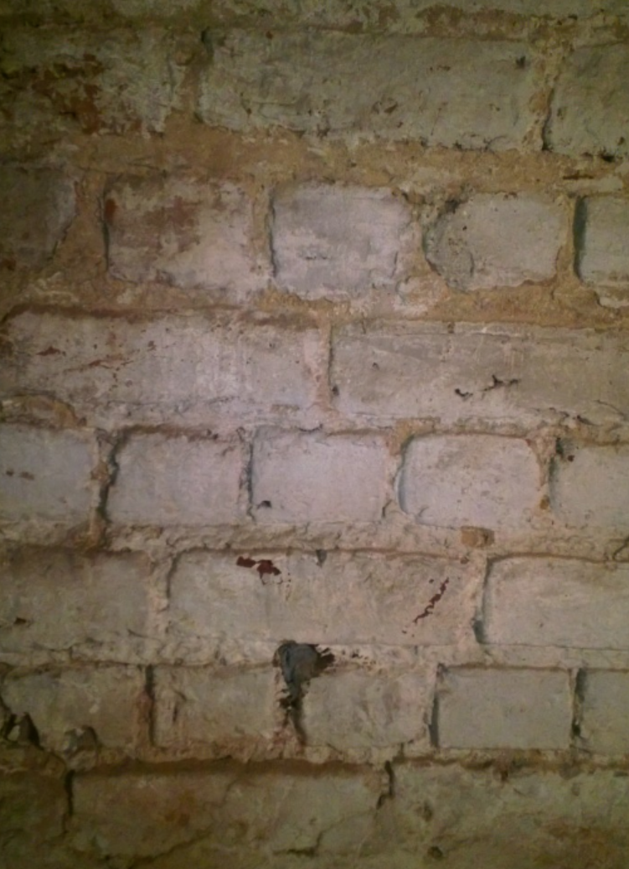

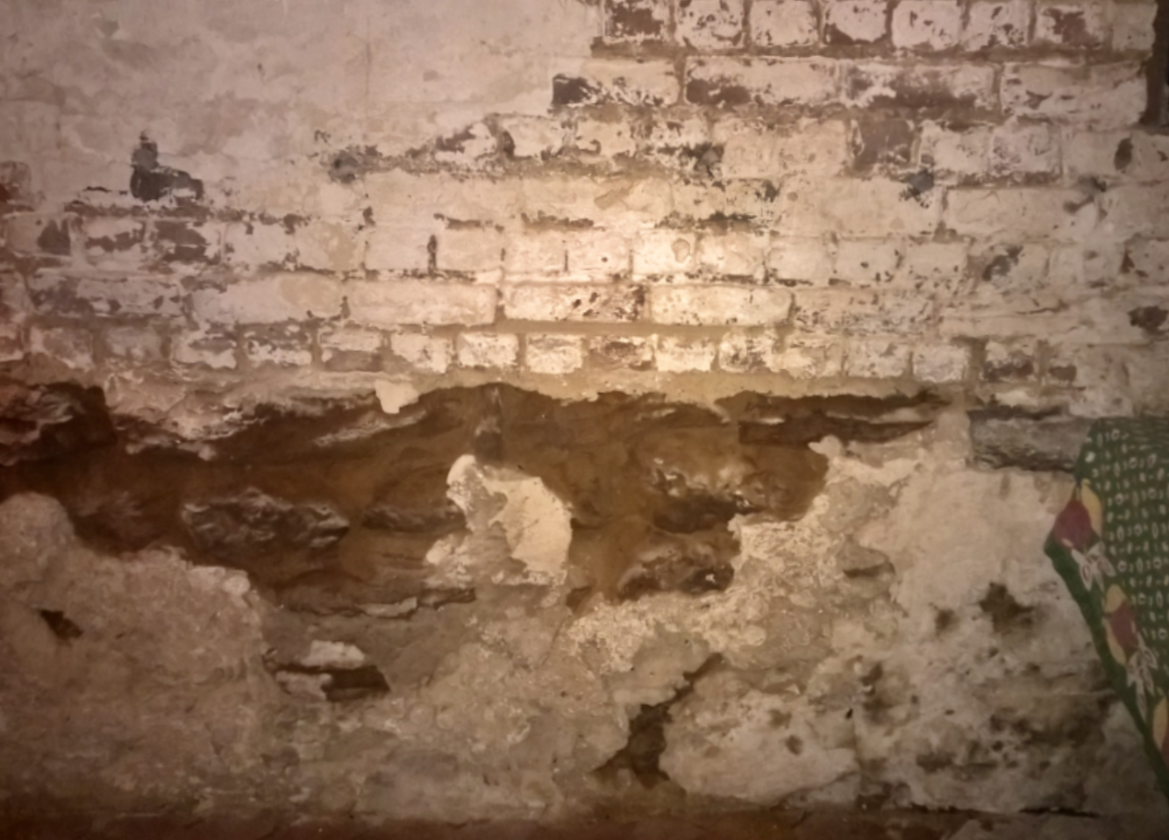
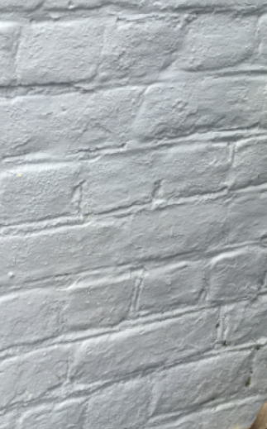
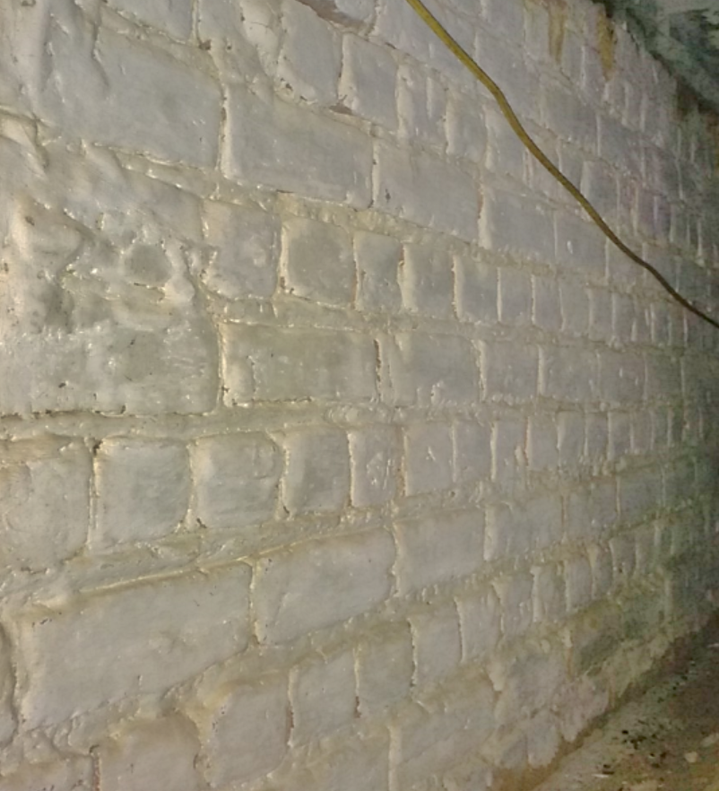
South-West Exterior
North-South Corner Exterior
South-West Interior
South Exterior
South Interior
North Interior
South Chimney
Partition Wall
(1820 addition)
Partition Wall
(1820 addition)
South Interior
Bricked Pit
South-East Interior
South-East Exterior

Slide 7

South-West Exterior
North-South Corner Exterior
South-West Interior
South Exterior
South Interior
North Interior
South Chimney
Partition Wall
(1820 addition)
Partition Wall
(1820 addition)
South Interior
Bricked Pit
South-East Interior
English Bond
South-East Exterior
South-East Exterior

Slide 8
English Bond over Bog-Iron Stone Foundation
South-West Exterior
North-South Corner Exterior
South-West Interior
South Exterior
South Interior
North Interior
South Chimney
Partition Wall
(1820 addition)
Partition Wall
(1820 addition)
South Interior
Bricked Pit
South-East Interior
South-East Exterior

Slide 9
English Bond
South-West Exterior
North-South Corner Exterior
South-West Interior
South Exterior
South Interior
North Interior
South Chimney
Partition Wall
(1820 addition)
Partition Wall
(1820 addition)
South Interior
Bricked Pit
South-East Interior
South-East Exterior

Slide 10
English Bond
South-West Exterior
North-South Corner Exterior
South-West Interior
South Exterior
South Interior
North Interior
South Chimney
Partition Wall
(1820 addition)
Partition Wall
(1820 addition)
South Interior
Bricked Pit
South-East Interior
South-East Exterior

Slide 11
English Bond at each side of Chimney
South-West Exterior
North-South Corner Exterior
South-West Interior
South Exterior
South Interior
North Interior
South Chimney
Partition Wall
(1820 addition)
Partition Wall
(1820 addition)
South Interior
Bricked Pit
South-East Interior
South-East Exterior

Slide 12

English Bond under Plaster
South-West Exterior
North-South Corner Exterior
South-West Interior
South Exterior
South Interior
North Interior
South Chimney
Partition Wall
(1820 addition)
Partition Wall
(1820 addition)
South Interior
Bricked Pit
South-East Interior
South-East Exterior

Slide 13
English Bond, unpainted under 1910 crawlspace
South-West Exterior
North-South Corner Exterior
South-West Interior
South Exterior
South Interior
North Interior
South Chimney
Partition Wall
(1820 addition)
Partition Wall
(1820 addition)
South Interior
Bricked Pit
South-East Interior
South-East Exterior

Slide 14
English Bond, unpainted under 1910 crawlspace, some areas retain a red-pigment wash
South-West Exterior
North-South Corner Exterior
South-West Interior
South Exterior
South Interior
North Interior
South Chimney
Partition Wall
(1820 addition)
Partition Wall
(1820 addition)
South Interior
Bricked Pit
South-East Interior
South-East Exterior

Slide 15
South-West Exterior
North-South Corner Exterior
South-West Interior
South Exterior
South Interior
North Interior
South Chimney
Partition Wall
(1820 addition)
Partition Wall
(1820 addition)
South Interior
Bricked Pit
English Bond over Bog-Iron Stone Foundation
South-East Interior
South-East Exterior

Slide 16
English Bond
South-West Exterior
North-South Corner Exterior
South-West Interior
South Exterior
South Interior
North Interior
South Chimney
Partition Wall
(1820 addition)
Partition Wall
(1820 addition)
South Interior
Bricked Pit
South-East Interior
South-East Exterior

Slide 17
English Bond over Bog-Iron Stone Foundation
South-West Exterior
North-South Corner Exterior
South-West Interior
South Exterior
South Interior
North Interior
South Chimney
Partition Wall
(1820 addition)
Partition Wall
(1820 addition)
South Interior
Bricked Pit
South-East Interior
South-East Exterior

Slide 18
English Bond, but non-matching pattern, much poorer mortar than joined south-wall
South-West Exterior
North-South Corner Exterior
South-West Interior
South Exterior
South Interior
North Interior
South Chimney
Partition Wall
(1820 addition)
Partition Wall
(1820 addition)
South Interior
Bricked Pit
South-East Interior
South-East Exterior

Slide 19
South-West Exterior
North-South Corner Exterior
South-West Interior
South Exterior
South Interior
North Interior
Partition Wall
(1820 addition)
South Chimney
Partition Wall
(1820 addition)
English Bond, with evident newer mortar and pattern than South interior wall
South Interior
Bricked Pit
South-East Interior
South-East Exterior

Slide 20
English Bond, but non-matching pattern, much poorer mortar than joined north-wall
South-West Exterior
North-South Corner Exterior
South-West Interior
South Exterior
South Interior
North Interior
South Chimney
Partition Wall
(1820 addition)
Partition Wall
(1820 addition)
South Interior
Bricked Pit
South-East Interior
South-East Exterior

Slide 21
Flemish Bond, with Queen Closers
South-West Exterior
North-South Corner Exterior
South-West Interior
South Exterior
South Interior
North Interior
South Chimney
Partition Wall
(1820 addition)
Partition Wall
(1820 addition)
South Interior
Bricked Pit
South-East Interior
South-East Exterior

Slide 22
Mahockney Cellar (North side)

Slide 23

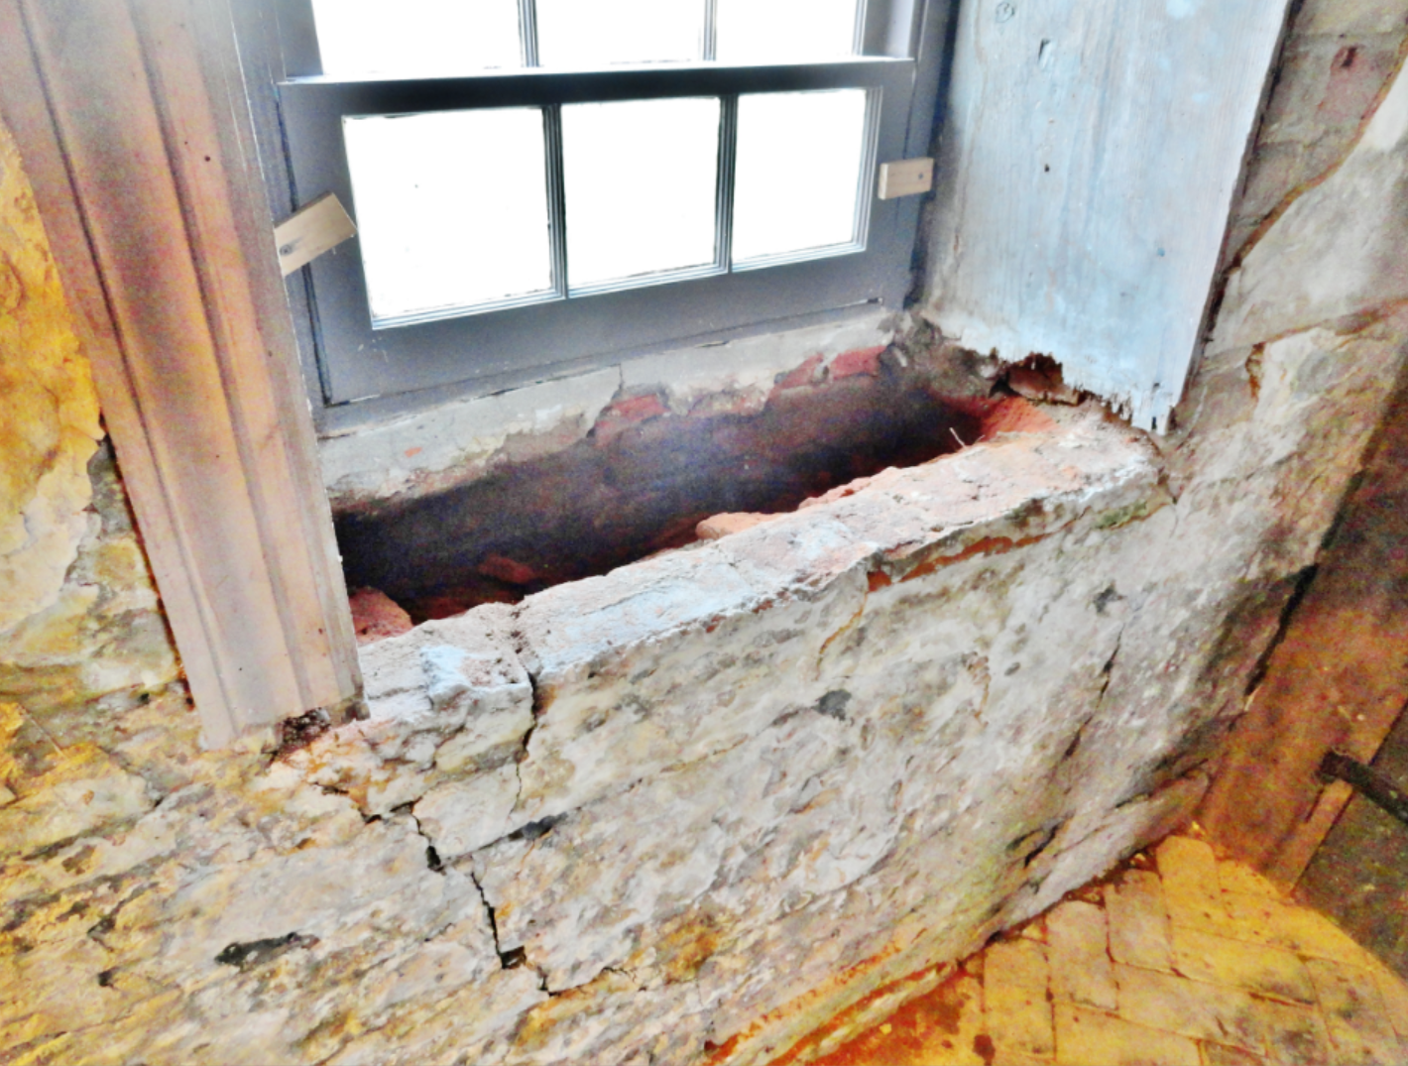
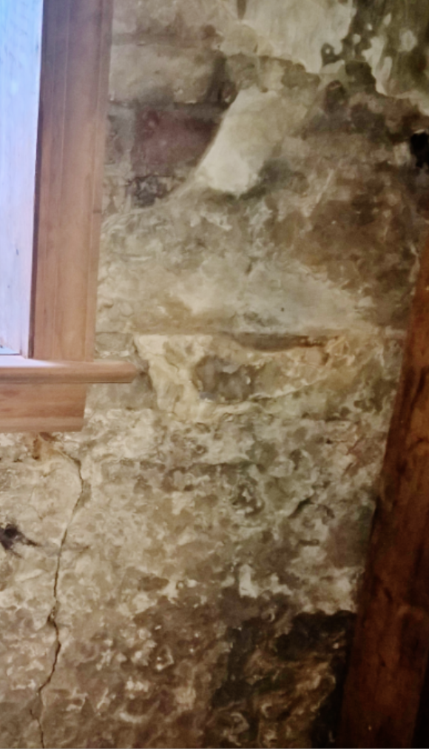
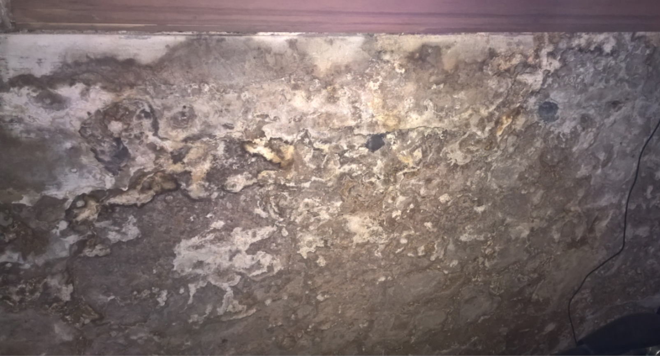
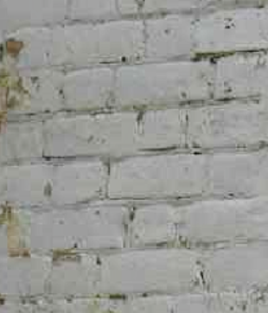
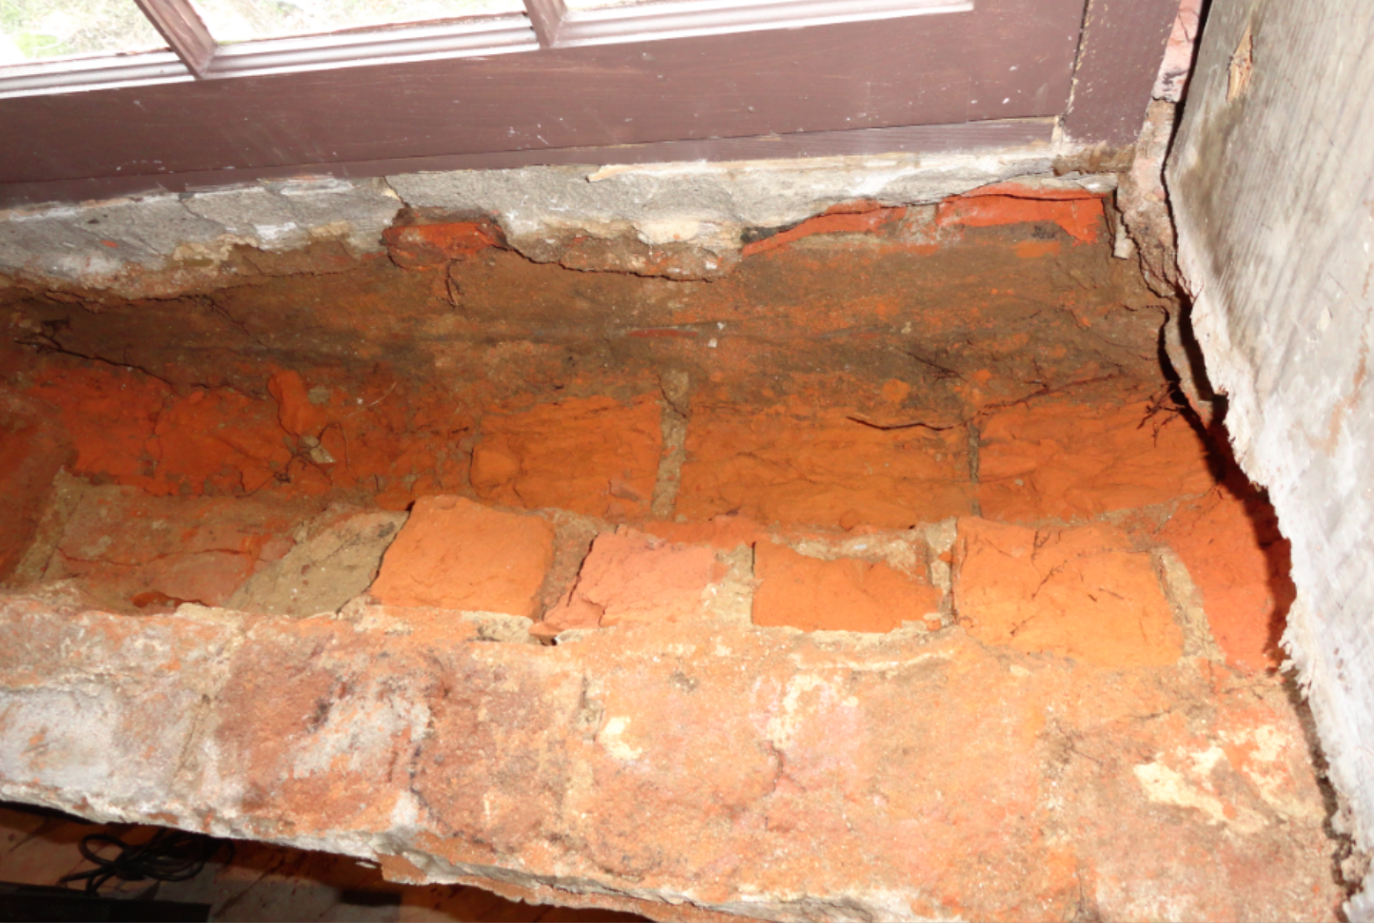
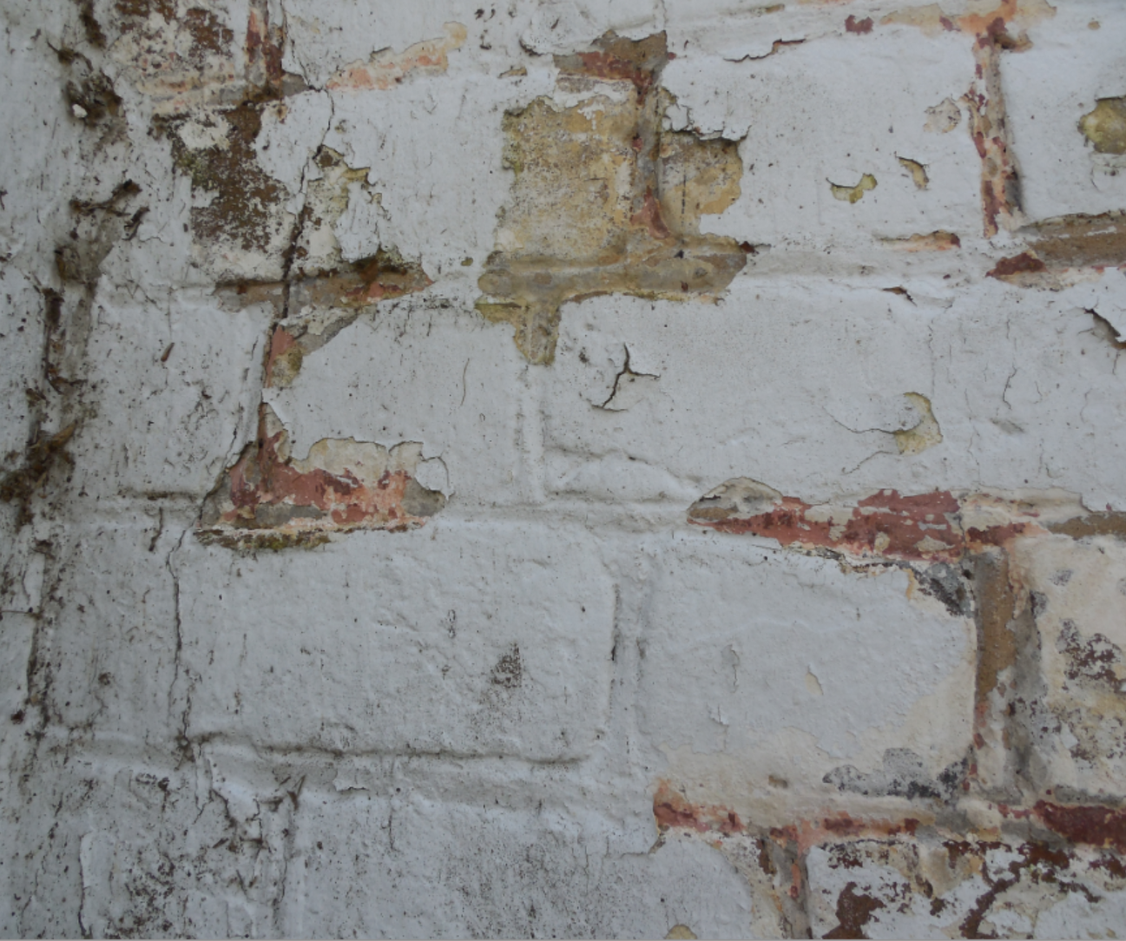
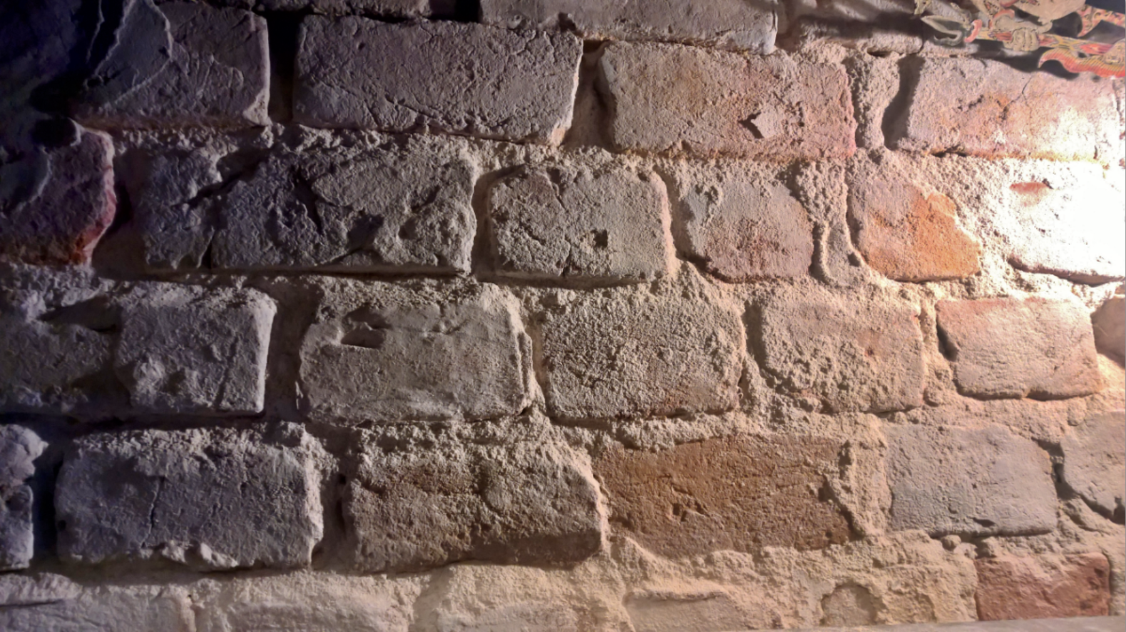
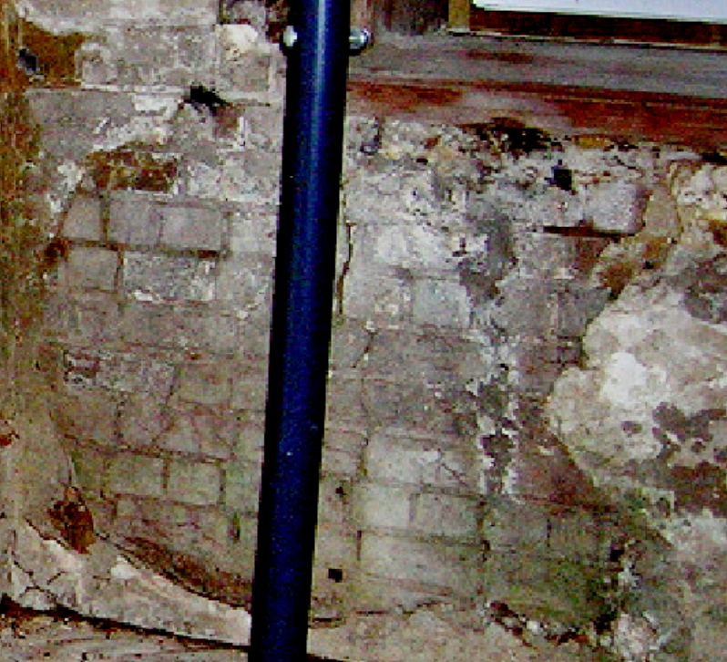
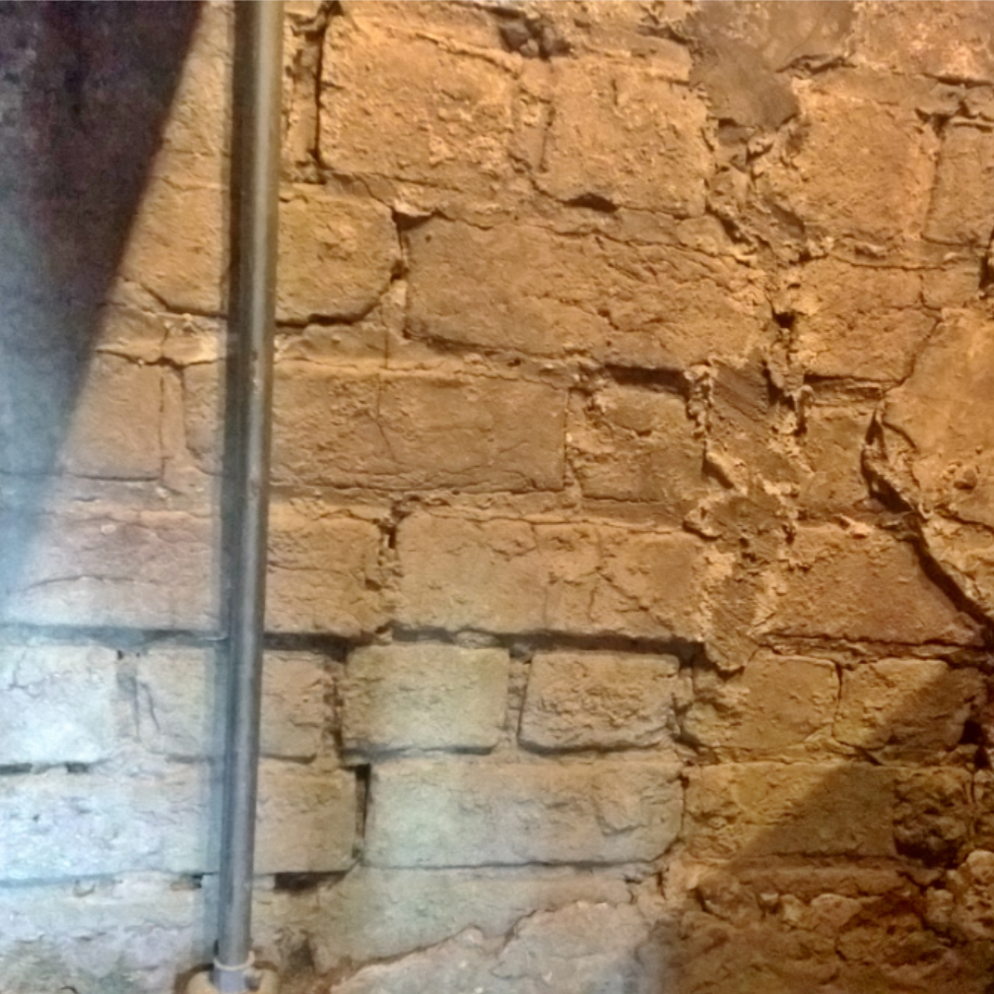
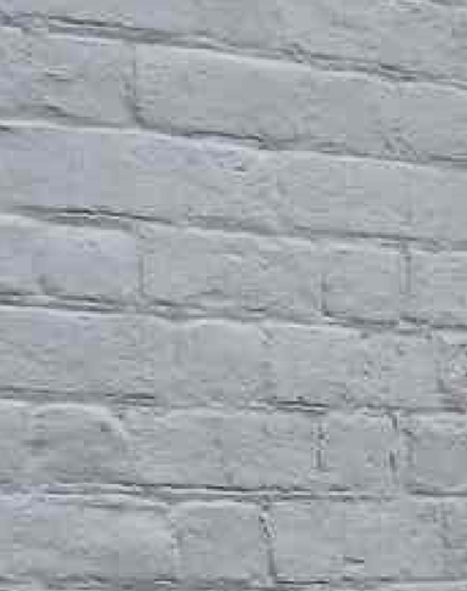
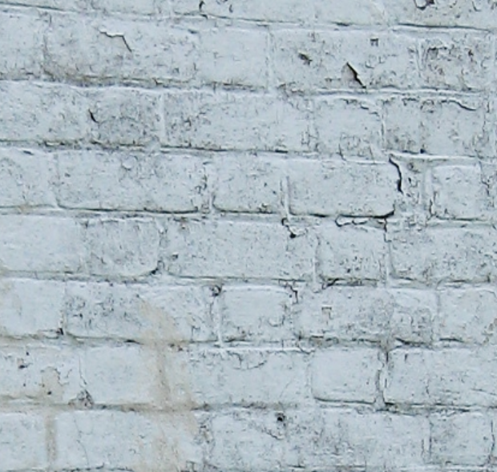
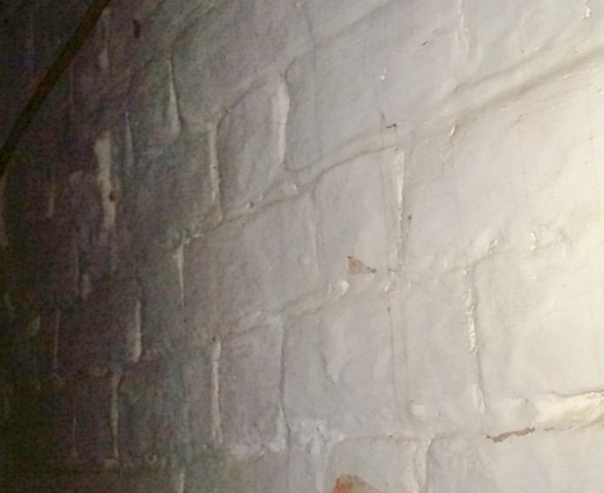

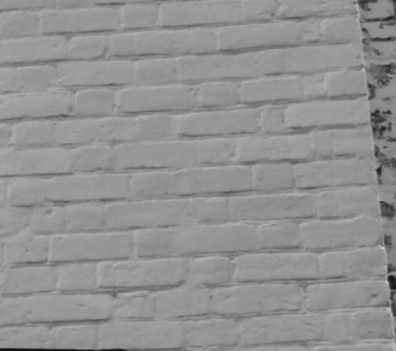
North-West Exterior
North Exterior
North-West Interior
North Chimney
North Interior
North-East Exterior
North-East Interior
North-East Exterior

Slide 24
Flemish Bond
North-West Exterior
North Exterior
North-West Interior
North Chimney
North Interior
North-East Exterior
North-East Interior
North-East Exterior

Slide 25
Three-Course American Bond
North-West Exterior
North Exterior
North-West Interior
North Chimney
North Interior
North-East Exterior
North-East Interior
North-East Exterior

Slide 26
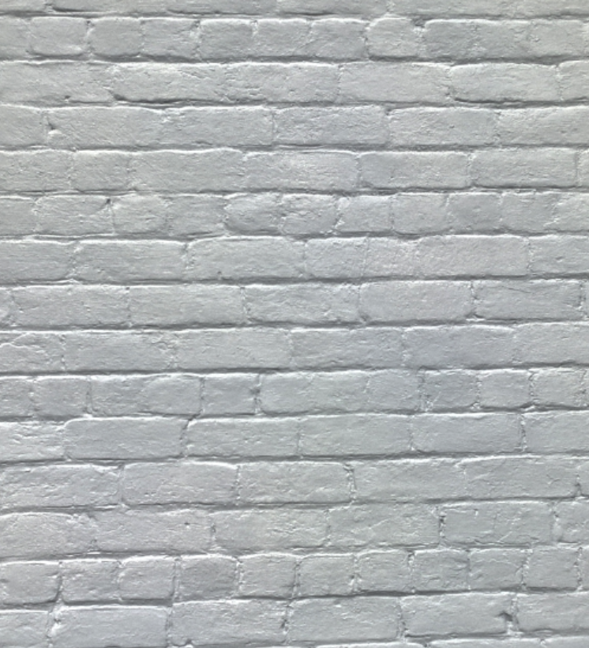
Three-Course American Bond
North-West Exterior
North Exterior
North-West Interior
North Chimney
North Interior
North-East Exterior
North-East Interior
North-East Exterior

Slide 27
Three-Course American Bond under plaster
North-West Exterior
North Exterior
North-West Interior
North Chimney
North Interior
North-East Exterior
North-East Interior
North-East Exterior

Slide 28

Flemish Bond
North-West Exterior
North Exterior
North-West Interior
North Chimney
North Interior
North-East Exterior
North-East Interior
North-East Exterior

Slide 29

Flemish Bond
North-West Exterior
North Exterior
North-West Interior
North Chimney
North Interior
North-East Exterior
North-East Interior
North-East Exterior

Slide 30
Irregular Bond
North-West Exterior
North Exterior
North-West Interior
North Chimney
North Interior
North-East Exterior
North-East Interior
North-East Exterior

Slide 31
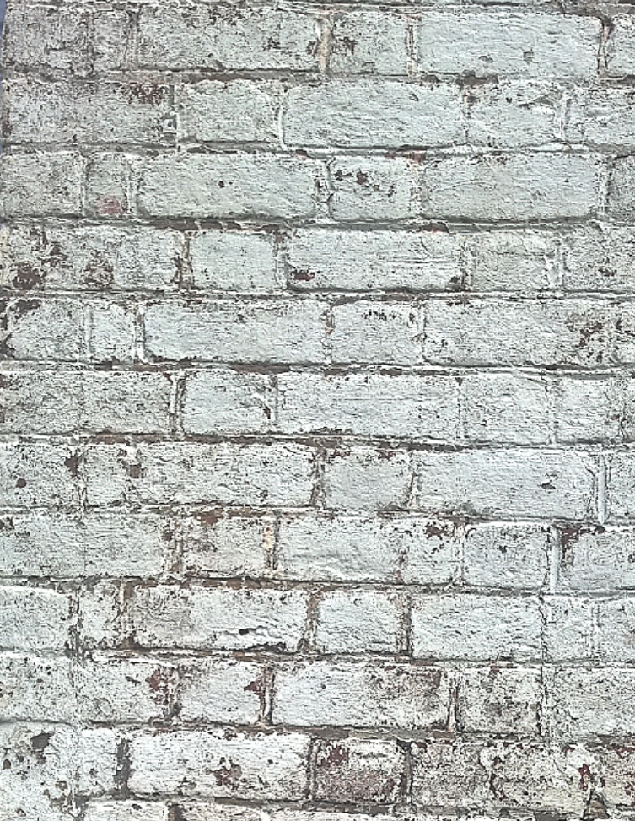
Flemish Bond, with Queen Closers
North-West Exterior
North Exterior
North-West Interior
North Chimney
North Interior
North-East Exterior
North-East Interior
North-East Exterior

